Slide 1

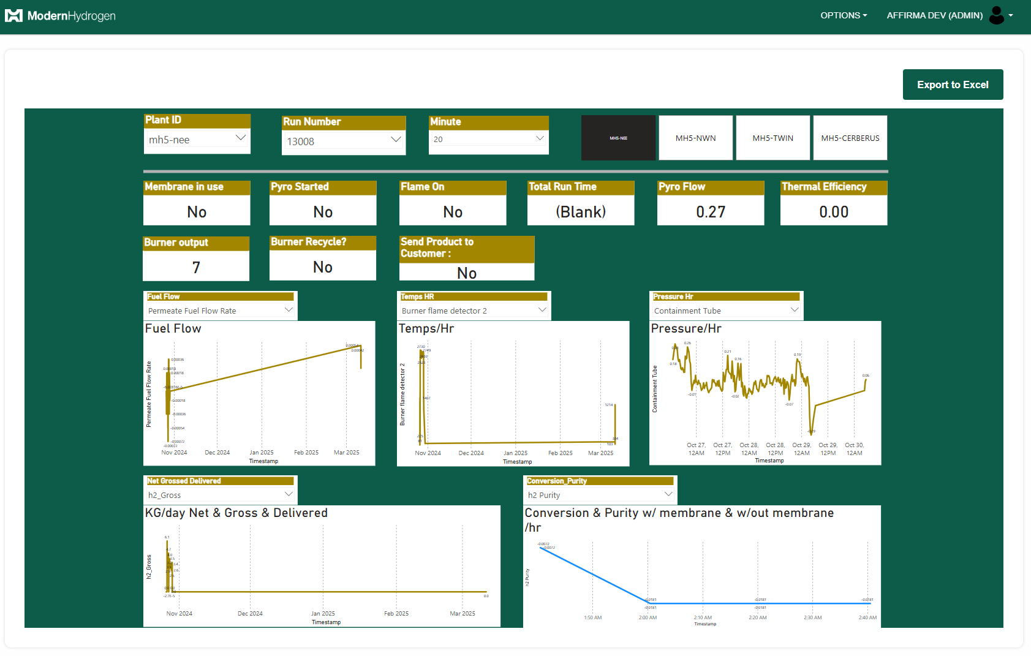
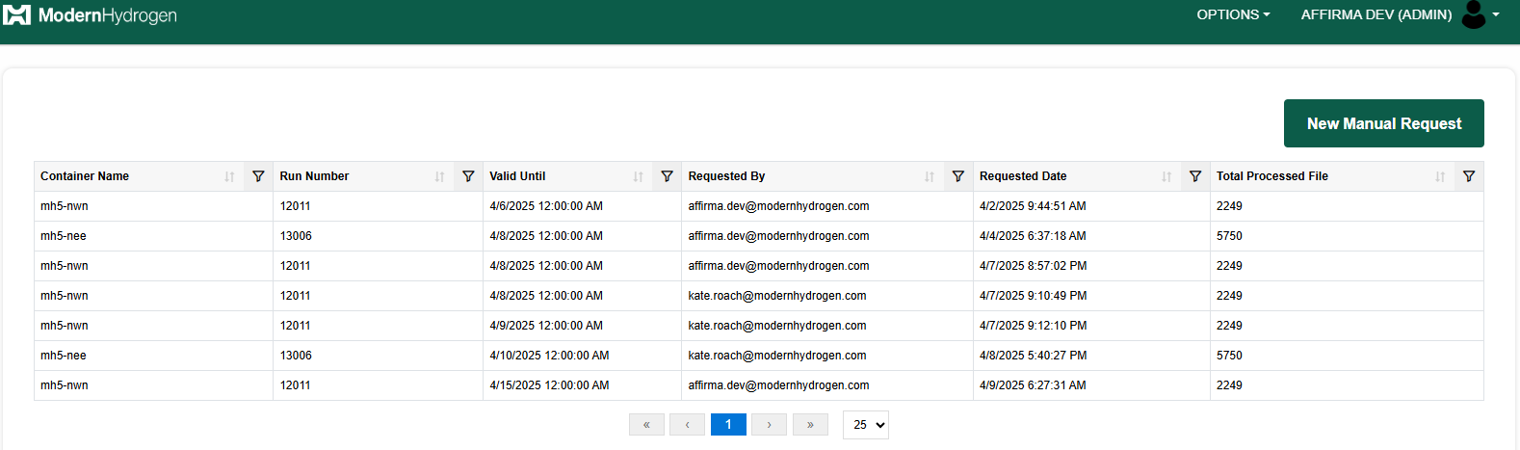
Command Center Application
Business Need
Modern Hydrogen is a clean energy company that decarbonizes natural gas by converting it into hydrogen for onsite energy use and solid carbon for durable infrastructure materials. Modern Hydrogen required a centralized, secure, and scalable platform to monitor and manage data from hydrogen production plants in real-time and handle large volumes of PLC data efficiently. Additionally, there was a need for configurable data archival, historical data access, and manual data import capabilities to ensure data integrity, flexibility, and operational continuity.
Outcomes
Developed a Command Center web app with user-friendly dashboards for real-time monitoring.
Ability to manage Plants and plant data ingestion configuration with custom retention options.
Enabled Admins to perform Manual Data Imports from BLOB to SQL with configurable date ranges and expiry for historical analysis.
Enforced strong Security Protocols, including encryption at rest, role-based Azure access, and use of KeyVault for secret management.

